Slide 1

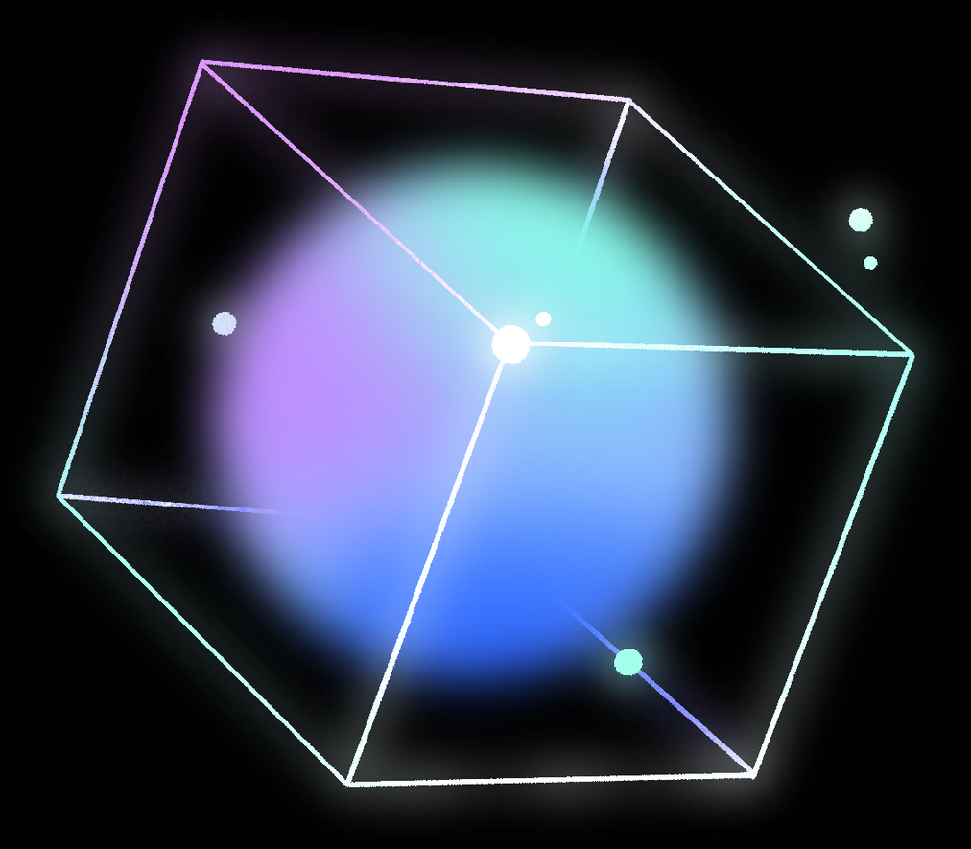




STUDY TRACKER DISCORD BOT
PROJECT
BY - SHAUN ALAN JOSEPH
AKHIL K
VENKAT JASWANTH I
NIVIEN M
RAMAVATH KARTHIK

Slide 2
PROBLEM STATEMENT -
WITH THE INCREASE IN POPULARITY OF DISCORD AMONG STUDENTS,
USING A DATABASE TO HELP PLAN TASKS AND STUDY EFFIECIENTLY COULD DRASTICALLY INCREASE THE QUALITY OF LIFE FOR THEM.
Project - Overview
Motivation
ER -Diagram
Implementation
RESULT
03
04
05
06
17

Slide 3
PROJECT OVERVIEW
Project Name: Study Tracker Discord Bot
Project Type: A Discord bot to study efficiently
Python Libraries used:
discord.py
psycopg2
google-generativeai
python-dateutil
Features:
AI Chat Bot
Task Management
Songs Playlist
Flash Cards
Reminders

Slide 4
MOTIVATION
With the rising popularity of discord among students, this bot helps with fighting procrastination with features like Task Management.
The bot also helps with actual studying with the feature of Flash Cards and music playlists to help focus.
It also has an inbuilt AI Chatbot to help with studying.
Since all of this is done on Discord there is no need for the Student to use multiple apps to do these things so this bot is very convenient for them.

Slide 5
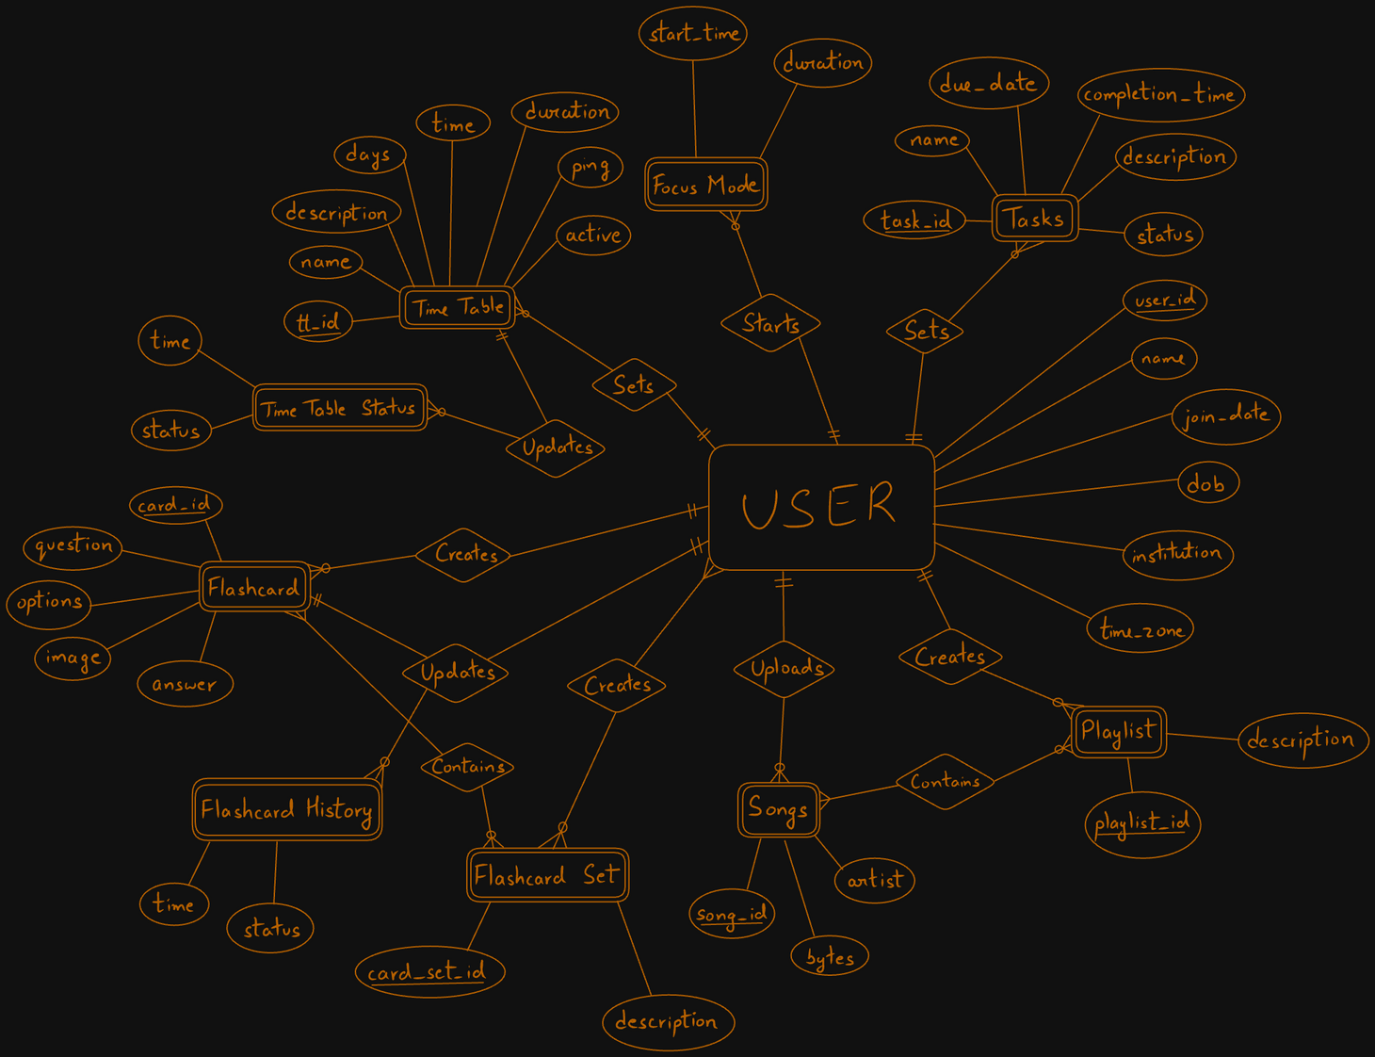
E R - DIAGRAM

Slide 6

IMPLEMENTATION
"CREATE TABLE USERS("
"USER_ID BIGINT PRIMARY KEY,"
"NAME VARCHAR(64) NOT NULL,"
"JOIN_DATE BIGINT NOT NULL,"
"DOB BIGINT,"
"INSTITUTION VARCHAR(256),"
"TIME_ZONE SMALLINT"
")"
"CREATE TABLE TASKS("
"TASK_ID SERIAL PRIMARY KEY,"
"USER_ID BIGINT NOT NULL,"
"NAME VARCHAR(128) NOT NULL,"
"DESCRIPTION TEXT,"
"STATUS VARCHAR(32),"
"DUE_DATE BIGINT,"
"COMPLETION_TIME BIGINT"
")"

Slide 7
IMPLEMENTATION (CONTINTUATION)
"CREATE TABLE TIME_TABLE("
"tt_id VARCHAR(12) PRIMARY KEY,"
"user_id BIGINT NOT NULL,"
"name VARCHAR(128) NOT NULL,"
"description TEXT,"
"days SMALLINT NOT NULL,"
"time SMALLINT NOT NULL,"
"duration SMALLINT,"
"ping BOOLEAN NOT NULL,"
"active BOOLEAN NOT NULL,"
"FOREIGN KEY (user_id) REFERENCES Users(user_id)"
")"
"CREATE TABLE TIME_TABLE_STATUS("
"tt_id VARCHAR(12) NOT NULL,"
"time BIGINT NOT NULL,"
"status VARCHAR(32),"
"PRIMARY KEY (tt_id, time),"
"FOREIGN KEY (tt_id) REFERENCES Time_Table(tt_id)"
")"

Slide 8
IMPLEMENTATION (CONTINTUATION)
"CREATE TABLE SONGS("
"song_id VARCHAR(12) PRIMARY KEY,"
"user_id BIGINT NOT NULL,"
"name VARCHAR(128) NOT NULL,"
"bytes bytea NOT NULL,"
"artist VARCHAR(64) NOT NULL,"
"FOREIGN KEY (user_id) REFERENCES Users(user_id)"
")"

Slide 9
IMPLEMENTATION (CONTINTUATION)
"CREATE TABLE PLAYLIST("
"playlist_id VARCHAR(12) PRIMARY KEY,"
"user_id BIGINT NOT NULL,"
"name VARCHAR(128) NOT NULL,"
"FOREIGN KEY (user_id) REFERENCES Users(user_id)"
")"
"CREATE TABLE PLAYLIST_SONGS("
"playlist_id VARCHAR(12),"
"song_id VARCHAR(12),"
"PRIMARY KEY (playlist_id, song_id),"
"FOREIGN KEY (playlist_id) REFERENCES Playlist(playlist_id),"
"FOREIGN KEY (song_id) REFERENCES Songs(song_id)"
")"

Slide 10
IMPLEMENTATION (CONTINTUATION)
"CREATE TABLE FLASHCARD("
"card_id VARCHAR(12) PRIMARY KEY,"
"user_id BIGINT NOT NULL,"
"question TEXT NOT NULL,"
"options TEXT[],"
"answer TEXT,"
"image BYTEA,"
"FOREIGN KEY (user_id) REFERENCES Users(user_id)"
")"

Slide 11
IMPLEMENTATION (CONTINTUATION)
"CREATE TABLE FLASHCARD_SET("
"card_set_id VARCHAR(12) PRIMARY KEY,"
"name VARCHAR(128) NOT NULL,"
"owner BIGINT NOT NULL,"
"description TEXT,"
"FOREIGN KEY (owner) REFERENCES Users(user_id)"
")"
"CREATE TABLE FLASHCARD_SET_ACCESS("
"card_set_id VARCHAR(12),"
"user_id BIGINT,"
"PRIMARY KEY (card_set_id, user_id),"
"FOREIGN KEY (card_set_id) REFERENCES Flashcard_Set(card_set_id),"
"FOREIGN KEY (user_id) REFERENCES Users(user_id)"
")"

Slide 12
IMPLEMENTATION (CONTINTUATION)
"CREATE TABLE FLASHCARD_SET_CARDS("
"card_set_id VARCHAR(12),"
"card_id VARCHAR(12),"
"added_by BIGINT NOT NULL,"
"PRIMARY KEY (card_set_id, card_id),"
"FOREIGN KEY (card_set_id) REFERENCES Flashcard_Set(card_set_id),"
"FOREIGN KEY (card_id) REFERENCES Flashcard(card_id)"
")"
"CREATE TABLE FLASHCARD_HISTORY("
"card_id VARCHAR(12),"
"user_id BIGINT,"
"time BIGINT,"
"correct BOOLEAN,"
"PRIMARY KEY (card_id, user_id, time),"
"FOREIGN KEY (card_id) REFERENCES Flashcard(card_id),"
"FOREIGN KEY (user_id) REFERENCES Users(user_id)"
")"

Slide 13
IMPLEMENTATION (CONTINTUATION)
"CREATE TABLE FLASHCARD_SET_CARDS("
"card_set_id VARCHAR(12),"
"card_id VARCHAR(12),"
"added_by BIGINT NOT NULL,"
"PRIMARY KEY (card_set_id, card_id),"
"FOREIGN KEY (card_set_id) REFERENCES Flashcard_Set(card_set_id),"
"FOREIGN KEY (card_id) REFERENCES Flashcard(card_id)"
")"
"CREATE TABLE FLASHCARD_HISTORY("
"card_id VARCHAR(12),"
"user_id BIGINT,"
"time BIGINT,"
"correct BOOLEAN,"
"PRIMARY KEY (card_id, user_id, time),"
"FOREIGN KEY (card_id) REFERENCES Flashcard(card_id),"
"FOREIGN KEY (user_id) REFERENCES Users(user_id)"
")"

Slide 14




TESTING AND VALIDATION
Task Management:
Create a task and verify it appears in the database.
Update a task and check if changes are reflected.
Delete a task and ensure it is removed from the database.
Retrieve tasks for a user and ensure correct data is fetched.
01
Playlist Management:
Create a playlist and add songs, then verify through fetching.
Update playlist details and check for changes.
Delete a playlist and ensure all related songs are also handled
02

Slide 15
TESTING AND VALIDATION
Notifications and Reminders:
Set a reminder for a task and check if the notification is triggered at the right time.
03

Slide 16
RESULT
SUCCESSFULLY DEVELOPED A FULLY FUNCTIONAL DISCORD BOT THAT ASSISTS WITH STUDYING USING DATABASES.
REAL -TIME DATA UPDATES ACHIEVED WITH DYNAMIC INTERACTIONS BETWEEN DISCORD, BACKEND AND THE DATABASE.
DESIGNED A TASK MANAGEMENT FEATURE TO HELP EASILY TRACK CURRENT TASKS.
INTEGRATED A AI CHATBOT TO ASSIST WITH STUDIES.
IMPLEMENTED SONG PLAYLISTS TO HELP FOCUS WHILE STUDYING.
ENABLED USERS TO CREATE FLASH CARDS WHICH HELPS USERS RECALL IMPORTANT POINTS AND STUDY MORE EFFICIENTLY.

Slide 17

THANK YOU!

